Slide 1

KEY FACTORS THAT INFLUENCE FOOD INTAKE IN MAMMALS
GROUP 8

Slide 2
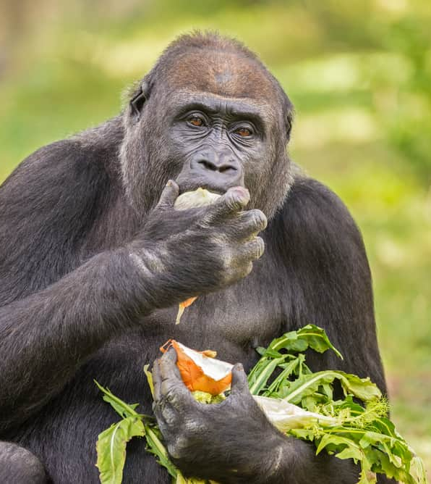
OUTLINE
INTRODUCTION
SOME FACTORS THAT INFLUENCE FOOD UPTAKE
CONCLUSION

Slide 3
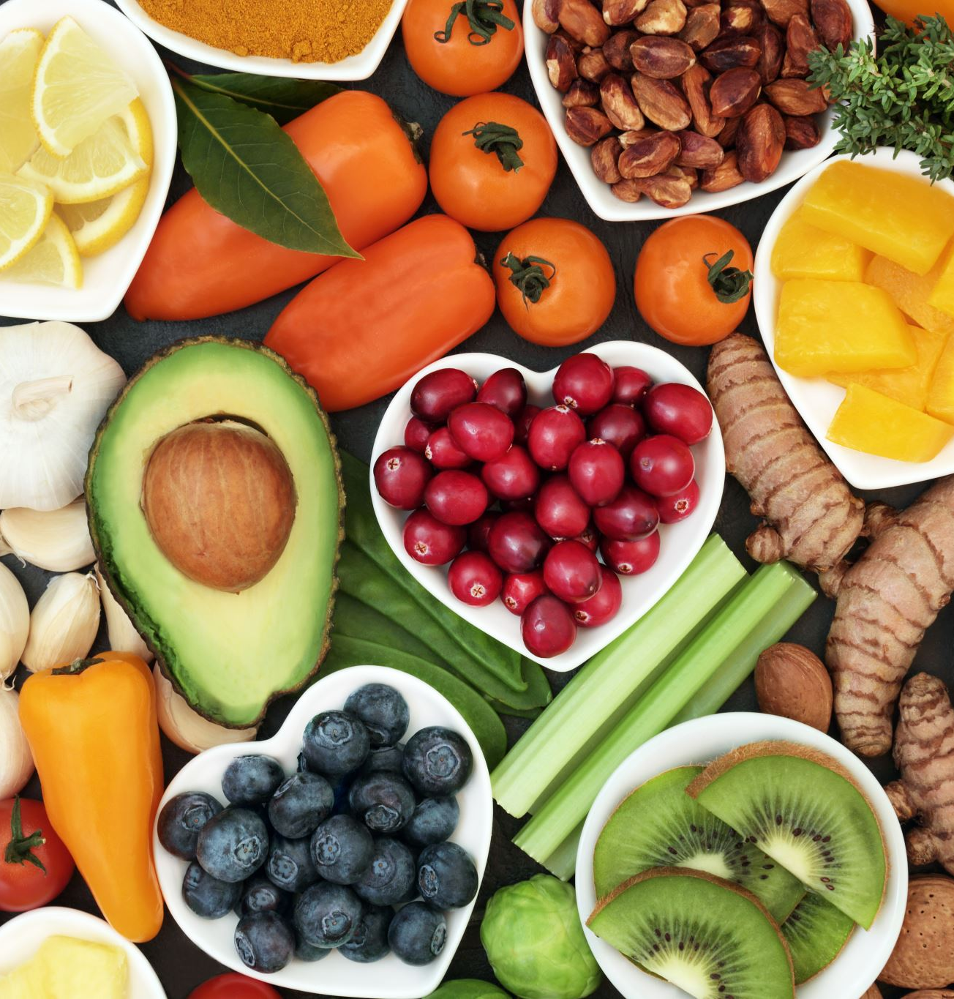
INTRODUCTION
Food intake is an essential aspect of life, not only sustaining us but also influencing our overall health and well-being.
Physiological, psychological, and environmental factors regulate food intake in mammals, including humans.

Slide 4
FACTORS THAT INFLUENCE FOOD INTAKE
Hunger and Satiety Signals
Blood Glucose Levels
Digestive System Signals
Hormones
Brain and Central Nervous System
Circadian Rhythms
External Cues and Environmental Factors

Slide 5
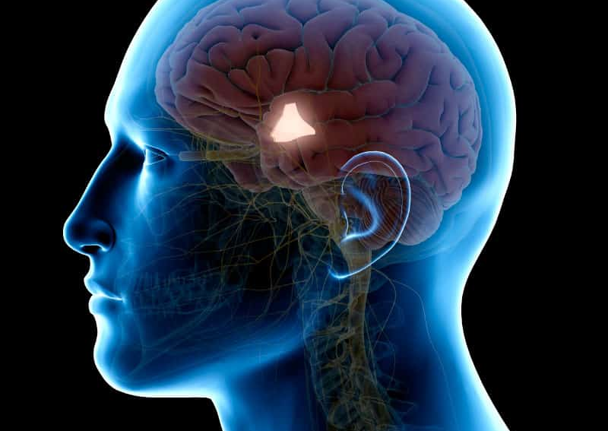
BRAIN AND CENTRAL NERVOUS SYSTEM
The hypothalamus integrates hunger and satiety signals.
The brainstem and reward centers influence pleasure and motivation related to eating.
Neurotransmitters like serotonin, dopamine, and endorphins impact mood and eating behaviors.

Slide 6
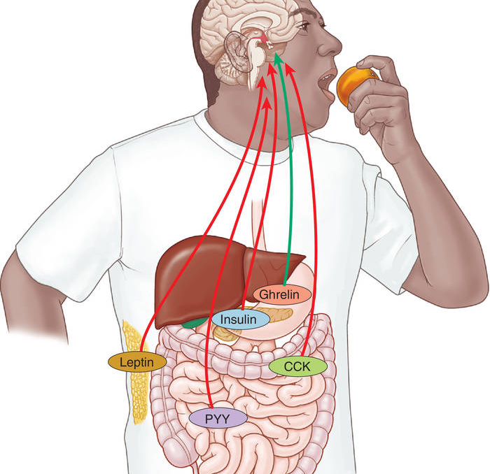
Hunger and Satiety Signals
The hypothalamus in the brain regulates food intake.
Ghrelin is the hunger hormone and is produced in the stomach when it's empty, stimulating appetite.
Leptin is the satiety hormone and is produced by fat cells, signaling fullness.
Cholecystokinin (CCK) is released by the small intestine after eating, promoting fullness.
Peptide YY (PYY) is released by the gastrointestinal tract, signaling satiety.
Insulin, produced by the pancreas, can suppress appetite.

Slide 7
EXTERNAL CUES AND ENVIRONMENTAL FACTORS
Sight and smell of food can trigger appetite even when not physically hungry.
01
Portion sizes and plate sizes can impact food consumption.
02
Cultural influences on eating habits can differ between regions and societies.
03

Slide 8
CONCLUSION
Understanding the key factors that regulate food intake in mammals is vital for promoting healthy eating habits. By being aware of these factors, we can make informed choices and develop a healthier relationship with food. Let's embrace mindful eating for a happier and healthier life.

Slide 9


Slide 10
REFERENCES
Cummings, D. E., & Overduin, J. (2007). Gastrointestinal regulation of food intake. The Journal of clinical investigation, 117(1), 13-23.
Stanley, S., Wynne, K., McGowan, B., & Bloom, S. (2005). Hormonal regulation of food intake. Physiological reviews.
Anand, B. K. (1961). Nervous regulation of food intake. Physiological Reviews, 41(4), 677-708.
Hopkins, M., Blundell, J., Halford, J., King, N., & Finlayson, G. (2016). The regulation of food intake in humans. Endotext [internet].
Mayer, J., & Thomas, D. W. (1967). Regulation of Food Intake and Obesity: The regulation of food intake is complex; a number of abnormalities may cause obesity. Science, 156(3773), 328-337.

